Slide 1

Survey Sez…
Tips for better survey design
Wine Club Summit
April 6, 2010
Wells Fargo Center
Santa Rosa, CA

Slide 2
Agenda
➔
Bennett Valley Group “Who are you?”
Business Case “Why do I need customer feedback surveys?”
Survey Design “How do I create a short tasting room survey?”
Survey Results “What are the pitfalls”?”
Benchmarking “How does my winery performance compare”?”
Questions and Answers “What questions do you have?”
Next Steps “Where do we go from here?”

Slide 3
Introducing Bennett Valley Group
We have been able to help our winery clients answer the detailed questions they have about their customers in order to grow direct to consumer sales.
www.bennettvalleygroup.com
How are we differentiated from other vendors?
We have no overhead; our cost is much lower.
We have only a few clients: you get our undivided attention.
I do the analysis myself, as I teach statistics at College of Marin; you get to speak directly with the “mechanic” who does the work under the hood.
We link your customer’s sales history to their attitudes and beliefs so that we can determine what levers to pull to increase sales through your DTC channels.
Our results are “actionable” giving you insights you can’t get elsewhere

Slide 4
Our clients
Updated 2016
Chateau Montelena
Cakebread Cellars
Chappellet Winery
Benovia Winery
Vineyard and Winery Management magazine
Medlock Ames Winery
CANVAS
Patz-Hall Winery
Robert Craig Winery
Rombauer Vineyards
Silverado Vineyards
Clos Du Val

Slide 5
Who are we?
Ross Goodwin
Ross is a twenty-six year veteran of Hewlett-Packard Company in marketing management and internal consulting to executives. He has deep experience in customer loyalty and VOC research to drive implementation of a competitively superior total customer experience.
As the corporate customer experience consultant, he led cross functional teams in various lines of businesses in the design and implementation of competitively superior customer experiences that drive revenue growth and improved profitability.
As the Corporate Manager of Customer Loyalty, he led the successful development and implementation of HP’s first B2B TCE survey and measurement system linkage architecture to meet the needs of the new CEO and Executive Committee.
He created the link to bottom-line business performance and worked with various divisions to implement strategic change, improve customer value and integrate customer-derived priorities into the strategic planning process.
Ross teaches statistics and other business classes at College of Marin
He is a former California "Baldrige" Examiner. He has an MBA in Finance from the University of California, Berkeley and a B.S in Physics and Mathematics from Sonoma State University.

Slide 6
Agenda
Bennett Valley Group “Who are you?”
Business Case “Why do I need customer feedback surveys?”
Survey Design “How do I create a short tasting room survey?”
Survey Results “What are the pitfalls”?”
Benchmarking “How does my winery performance compare”?”
Questions and Answers “What questions do you have?”
Next Steps “Where do we go from here?”
➔

Slide 7
What are the major concerns of your winery management team?
Business concerns?
Customer concerns?
What decisions do you need to make?
What data do you use to drive your decisions?
  The “rear-view mirror” problem

Slide 8
What is your experience in using customer surveys in the wine industry?
?
?
?
?

Slide 9

A Winery’s Whole Customer Experience
From awareness…to becoming a brand Ambassador.
And every point of interaction in between
Peet’s Coffee vs. Starbucks
  Quality is the experience vs.
  Quality is the product

Slide 10
Questions our winery clients are asking us about their DTC customers
Is my brand “blah”?
What are the psychographics of my customers? What are their attitudes and beliefs about us compared to our competitors?
How can I identify my most loyal customers so that I can enlist them as ambassadors for my winery?
How can I proactively identify customers who are most at risk of terminating their membership, so that I can save the relationship?
How are we viewed relative to our competitors in terms of our brand, our wines and our interaction with customers?
Who do our customers say are the best other wine clubs that they belong to and how do we compare to them on key performance metrics such as the tasting room and ecommerce and/or support channels such as phone and internet? Are we improving relative to the competition, or not?
What is our share of wallet compared to our competitors? Are we getting more than our fair share or less?
What specific actions do I need to take to improve customer loyalty and average tenure of club membership in order to grow sales through this most profitable channel?

Slide 11
Questions our winery clients are asking us about their DTC customers (cont’d)
Are there customer segments that we should be thinking about that would help us focus our efforts on increasing sales in our customer base?
What levers can we pull to promote positive word of mouth about our winery? Is there any negative word of mouth about our winery and, if so, what do we need to do to minimize it?
What are our customers saying about us? Where are we strong? Where do we need to improve?
We think our performance is great in all our channels for interacting with customers such as the tasting room as well as internet and phone. But how do I know for sure? How can I quantify this using direct feedback from our customers?
What do we need to do to grow our Millennial and GenX customer base? How do they feel about our winery compared to others?
How do customers view our quality price ratio as compared to our competitors? Do their attitudes and beliefs align with reality? If not, what should we do to correct these misperceptions?

Slide 12
Questions our winery clients are asking us about their DTC customers (cont’d)
What wine websites and magazines do our customers use and does this influence buying behavior in a positive or negative way? Are wine critic ratings important to our sales? Is our PR strategy effective?
As customers accrue more loyalty points, are they actually more loyal to us? How do I know for sure that I am not just “buying” their loyalty?
How do customers first hear about us? What can I do so that more customers hear about us in a positive way?

Slide 13
BVG Approach
Customer experience survey
  You can’t manage what you don’t measure
  Every customer interaction adds to, subtracts from or is neutral to the customers’ perception of your brand
  Map & Measure all relevant Touch Points (points of interaction) in the Customer Corridor
  Customers’ perceptions of your performance relative to the competition drives your business success
  Voice of the Customer (VoC) Feedback gives you a 360 degree view of what your customers’ think about how you are performing relative to competitors

Slide 14
Measuring key customer touch points
A Winery…
BVG Approach
The customer corridor encompasses the entire customer experience
capturing data at every touch point with a view to integrated data
Mags,
Ads, Direct Mail, Web,
Blogs,
Tweets, WoM
Image / Reputation
Join Private
Mailing
List
Winery
Events
Calling the
Winery
List
Membership
Etc., etc.
Customer entry
Customer Corridor
Tour &
Tasting
Products / Services
Exclusive
Membership
Events, Tastings,
Tours
Website
Customer
Communications
Competitor Promotion
Your customers’ 360 degree view of your Winery
Not your organizational silos
Notes:
Aka the lifecycle from awareness to loyalty to exit

Slide 15
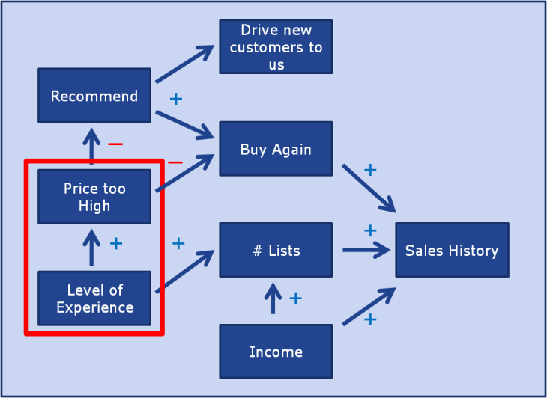
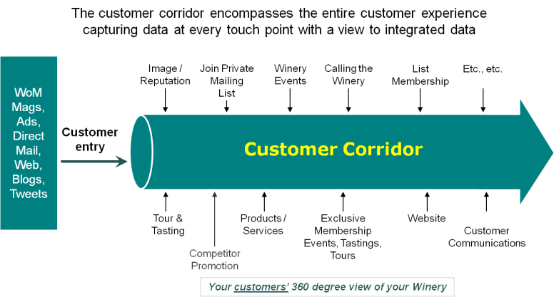
Wine Club Success Model
BVG Approach
What competitive gaps do we have in our customer experience performance?
Which gaps are most important to focus on?
What “levers” can we pull in improve our overall the total customer experience to increase positive WoM, increase retention, and drive sales growth through this channel?
Total Customer Experience
(TCE)
Winery PML / Club Sales

Slide 16
Agenda
Bennett Valley Group “Who are you?”
Business Case “Why do I need customer feedback surveys?”
Survey Design “How do I create a short tasting room survey?”
Survey Results “What are the pitfalls”?”
Benchmarking “How does my winery performance compare”?”
Questions and Answers “What questions do you have?”
Next Steps “Where do we go from here?”
➔

Slide 17
Ok, let’s say you want to conduct a Tasting room survey….
How many of you have a tasting room survey?
Has it been useful? (Why or why not?)

Slide 18
Ok, let’s say you want to conduct a Tasting room survey….
First, begin with the end in mind:
What is/are your Goals?
  ?
What are your strategies for achieving your goals?
  ?
What are your tactics for achieving your strategies?
  ?
Notes:
Ask what drives sales? Is it the taste of the wine? Is it the tasting room experience? Is it something else?
Share the Starbucks versus Peet’s story

Slide 19

Tasting room survey
Goals, strategies, tactics
Goal
  Best tasting room experience in my AVA
Strategies
  Measure key attributes of the experience (KPIs)
    Which drive sales?
    Which drive return visits?
    Which drive joining the wine club?
    Which servers drive top scores?
  Create action plans for improvement
  On-going monitoring of performance gains
Tactics
  On-site web-based survey via laptop, or paper based survey, or Email the web-based survey
  Periodic review of KPI performance with employees, stakeholders
  Periodic Newsletter updates to survey respondents, etc.
Notes:
The survey is not our goal. It helps us enable our goal

Slide 20
Tasting room survey
Outline
Introduction
How did you first hear about us?
Is this your first visit?
Did you make a purchase today?
Did you join our wine club today?
Who was your server?
Perceptions around key attributes of the experience
Open-ended comments
Additional questions of interest
Demographics
May we contact you?
Notes:
Purchase or not? Yields purchase driver information

Slide 21
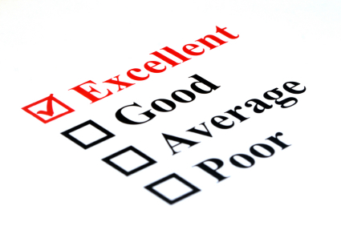
Tasting room survey
Detailed
Introduction
  Why should I take this survey? WIIFM?
How did you first hear about us?
  Visit to the winery
  Wine publication
  Wine website
  Winery recommendation
  Restaurant recommendation
  Wine shop recommendation
  Recommendation from a friend, relative or business associate
  Tasting event
  Facebook
  Twitter
  Yelp
  Blog
  Other
Is this your first visit?
Did you make a purchase today?
Did you join our wine club today?
  Yes
  No
  Already a member
Who was your server?
Perceptions around key attributes of the experience
  Overall tasting room experience
  Friendliness of the staff
  Professionalism of the staff
  Knowledge / competence of the staff
  Others?
Open-ended comments
  Why did you give us this rating?
  What could we do to improve?
Additional questions of interest
  Interest in other events
  Etc.
Demographics
  Age group
  Zip code
  Etc.
May we contact you?
  Contact info
Notes:
Purchase or not? Yields purchase driver information

Slide 22

Tasting room survey
Implementation
Web survey vendors
  Survey Monkey:
    Pro:
      most popular
      Free
      Reporting capabilities
    Con:
      Does not perform statistical analysis you need
        Their “Basic Statistics” is inadequate
        Are the differences statistically significant? Or are the differences just due to random error?
        What are the drivers of sales, return visits, membership signups? How do I know what to focus on?
      Does not provide a unique survey invite (URL)
      Does not allow upload of individual customer CRM data
        Cannot connect sales data to attitudes and beliefs

Slide 23
Agenda
Bennett Valley Group “Who are you?”
Business Case “Why do I need customer feedback surveys?”
Survey Design “How do I create a short tasting room survey?”
Survey Results “What are the pitfalls”?”
Benchmarking “How does my winery performance compare”?”
Questions and Answers “What questions do you have?”
Next Steps “Where do we go from here?”
➔

Slide 24

Tasting room survey
Ok, I have my results, now what?
Pitfalls

Slide 25
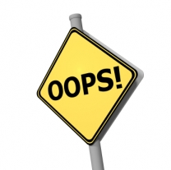
The #1 mistake in customer feedback surveys
Not performing statistical analysis
Means you can’t answer the critical business questions of interest:
  Did we actually move the KPIs or was that change just due to statistical fluctuation?
  Are our KPIs superior, at par, or inferior to the competition, or are the differences we are seeing just due to statistical bounce?
  Is server Samantha’s tasting room performance really better/worse than the norm?
  What levers can we pull to increase DTC sales and Word of Mouth?
    Requires statistical driver analysis

Slide 26
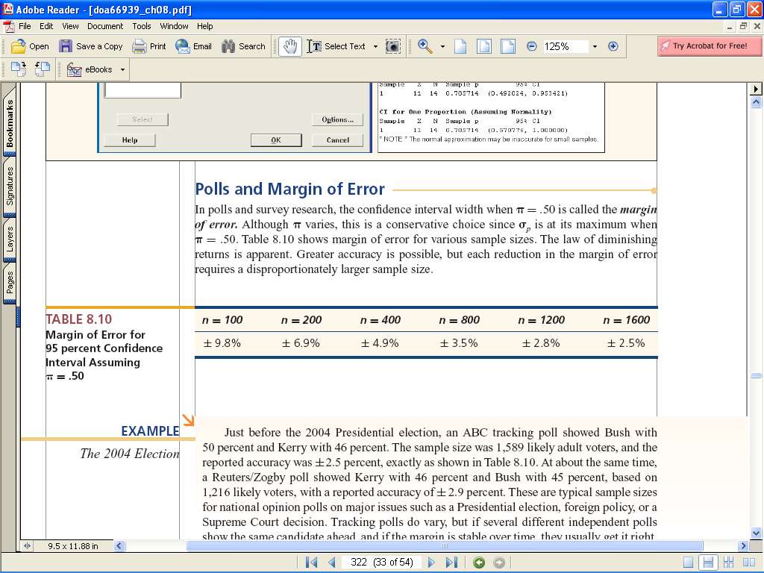
The accuracy of a proportion
Margin of error
Below are some worst-case margins of error for 95% confidence interval
Each reduction in the margin of error requires a disproportionately larger sample size.
8,000 club members with 20% response rate yields 1600 respondents
McGraw-Hill/Irwin
© 2007 The McGraw-Hill Companies, Inc. All rights reserved.
Notes:
Margin of error is defined as the half-width of the confidence interval: in other words the “+/-” value

Slide 27
Confidence interval calculation
Example
Proportions
Business Question
How accurate are our tasting room performance ratings?
Statistical Question
What is the 90% confidence interval for N = 342, 6.6% “Excellent”? (ten point scale)
√
p(1-p)
8.9%
SE =
= 0.013 (1.3%)
N
√
6.6%
.07(1-.07)
= +/- 0.023
90% CI = +/- 1.64 *
342
(2.3%)
4.3%
Rule of Thumb
N=400 95% Confidence ➔ +/- 5%

Slide 28
Confidence interval calculation
Example
Means
What is the 90% confidence interval for N = 342, Variance = 4.247, mean =6.95 (ten point scale)?
√
variance
7.13
SE =
= 0.11
N
√
mean = 6.95
4.247
= +/- 0.18
90% CI = +/- 1.64 *
342
Typical SPSS Output
6.77
Overall tasting room performance

Slide 29

The #2 mistake in customer feedback surveys
Not segmenting your customers
  Age Group
  DTC channel
  Etc.
Each segment is different: different needs, different drivers, different appraisals of KPI performance, etc.

Slide 30
The #3 mistake in customer feedback surveys
Not sharing the results
  with front-facing employees
Simply showing the grades to your employees and allowing them to see objectively how they’re doing through the eyes of real customers naturally changes employee behavior for the better.
How do we know if we’re doing it right? Simple. You should be able to ask the employees how they’re doing. If they know how they’re being graded – even generally – then you have connected the feedback loop.
If your employees don’t know how they’re doing, then that’s a problem.

Slide 31
The #3 mistake in customer feedback surveys (cont’d)
What happens when we stop sharing? A couple of things. First, the feedback loop stops functioning as employees stop receiving objective information about how they’re doing and how that compares to their peer locations. That’s a huge potential gain in store performance for practically zero additional dollars left sitting on the table.
Second, the initiative becomes a burden and a stress on front-line managers because it doesn’t capture the interest and momentum of employees. And that’s a problem. If employees aren’t interested and engaged in the idea of listening to objective customer feedback, then the measurement falls by the wayside when other priorities come up.
Making it work. The companies who make the most of customer feedback systematize the process of getting information to the front line.

Slide 32
The #3 mistake in customer feedback surveys (cont’d)
Not sharing the results
  with customers
Sharing what you learned, “we are listening to you”, and what you are doing to improve, “we care”, increases
  customer engagement,
  loyalty, and the
  sense of connectedness with the winery.
Increases future survey response rates

Slide 33
Agenda
Bennett Valley Group “Who are you?”
Business Case “Why do I need customer feedback surveys?”
Survey Design “How do I create a short tasting room survey?”
Survey Results “What are the pitfalls”?”
Benchmarking “How does my winery performance compare”?”
Questions and Answers “What questions do you have?”
Next Steps “Where do we go from here?”
➔

Slide 34

Moving your winery forward in 2010
Benchmark your winery performance against your competitors in key areas of performance
  Customer experience benchmarking
    Across points of interaction
  In various segments
    Age group
    DTC channel
    Etc.
Create and implement action plans to improve performance
Monitor performance
Repeat….

Slide 35
Brand Attribute Benchmarks
Your Winery (for each segment)
= Problem Areas

Slide 36
Touch Point Experience Benchmarks
Your Winery (for each segment)
= Problem Areas

Slide 37
Other Benchmarks
There many other benchmarks….
Here is one that is the “acid test”:

Slide 38

Q&A with Ross Goodwin
Bennett Valley Group
Mobile: 707.799.3124
Email: ross@bennettvalleygroup.com
Website: www.bennettvalleygroup.com

Slide 39
Appendix

Slide 40
Program
Wine Club Relationship Health Program
High-level view
Program Setup | Survey Recruitment | Field Survey & Analysis | Action Planning
Stakeholder Interviews Survey Design Validation of survey with key stakeholders | Pre-notification of survey from CEO setting customer expectations | Field Survey Follow up on non-respondents Follow-up with at-risk members Analyze Data and Create Management Re[port | Distribute Management Report Present Report to Management Team Winery Management works with Operations teams to create and implement action plans and stretch metrics Field new annual survey, compare metrics to goals, create new action plans and stretch metrics

Slide 41

Next Steps
Typical survey timeline
Timeline subject to availability of winery management team
Field survey: two weeks
Data analysis minimum of two weeks

Slide 42
Programmatic Approach
Total Customer Experience Gap Analysis
Customer Profile Survey
Total Customer Experience
(perceptions)
Customer Experience Survey
Gap 4
Creating and Delivering
Customer Tracking Survey
Execution and Delivery
Gap 4
Partners
&
Consultants
-Structures -Resources
Gap 1
-Processes -Culture
Closed-loop feedback
Listening and
Understanding
Gap 3
Leading
Gap 3
Business Focus
Monitoring and
Responding
Metrics, Strategies
and Plans
Gap 2
Aligning Strategies
Management's Perception
Beliefs and Vision

Slide 43
Common Sales / eCommerce / Wine Club Manager Goals
All addressable by customer surveys
Business Case
Stem attrition / increase retention: (Why are they leaving? What misperceptions are there that are addressable via better/more focused marketing?)
Grow sales: (What levers do we need to pull?)
Strengthen and deepen the relationships that we have with each of our wine club members. (What are the drivers of relationship health? How do we compare to the competition? Where do we need to focus our improvement efforts?)
Recover previous club members who have terminated their relationship with you (Who has left and why, what might attract them back?)
Enlist “Ambassadors” to promote our brand (Who are they? How might we enlist them? What messages should we arm them with?)
What are the perceptions of our quality-price ratio? (Are there misperceptions? What could marketing do to correct these misperceptions?)

Slide 44
Business Case
Benefits
Improve Club relationship health
  Uncover systemic issues that need to be fixed
  Improve brand/reputation
    Increase positive WoM behaviors among identified Promoters
    Decrease negative WoM behaviors among identified Detractors
Improve customer lifetime value
  Leverage new growth opportunities
  Improve up-sell, cross-sell
  Improve retention and sales revenues per member
    A 5% increase in retention rate increases sales revenues 5%
  Identify & recover members at risk to protect revenue and reduce churn
Improve competitive positioning
  Identify competitive advantages and gaps to drive selling strategies and improve competitive positioning
Improve team performance
  Use customer feedback as an element in the annual review process for your management & operations teams
  Tie compensation to customer feedback in a fair and objective manner

Slide 45

Questions
Types of questions
Many scale points versus few scale points
Odd scale points versus even scale points
Totally anchored versus end-point anchored
Open-ended versus closed-ended questions
Typical anchors
Not applicable, no experience, don’t know, refused options
Scale consistency
Scale sensitivity
Means versus top box scores

Slide 46
Questions
Types
factual information
  business environment
  usage
  demographic
beliefs
  direct (experiential)
  indirect (perceptual)
attitudes
  evaluations (e.g. overall satisfaction, best-in-class)
behavioral prediction (intent to behave)
  e.g. likely to repurchase, likely to recommend, top of mind awareness, most preferred, will only consider this supplier
Open ended
  Why do you say that?

Slide 47
Questions
Many scale points versus few scale points
fewer points attenuate correlations requiring larger sample for statistically significant drivers
more unanchored points increase reliability for increased statistical precision (e..g mean), more discrimination & sensitivity to movement.
more anchored points increases time per question
no/yes separates severity from frequency of occurrence
more than two points compounds severity and frequency
no scale is normally distributed
0
1
2
3
4
5
6
7
8
9
10
1
2
3
4
5
6
7
8
9
10
1
2
3
4
5
6
7
1
2
3
4
5
1
2
3
4
1
2
3
No
Yes

Slide 48
Questions
Odd scale points versus even scale points
Is neutrality desirable? if not, even point scales force respondents off the fence, but raises the issue of reliability
odd scales
  totally anchored “balanced scales” allow for fence sitting
  totally anchored “unbalanced” scale prevents neutrality
0
1
2
3
4
5
6
7
8
9
10
1
2
3
4
5
6
7
8
9
10
1
2
3
4
5
6
7
1
2
3
4
5
1
2
3
4
1
2
3
No
Yes
the “fence”
(neutrality)

Slide 49
Questions
Totally anchored versus end-point anchored
end point anchored
  interval scale allows for means, fast administration
  less intuitive, less interpretable by senior management
poor
performance
1
2
3
4
5
6
7
8
9
10
excellent
performance

Slide 50
Questions
Totally anchored versus end-point anchored
totally anchored
  intuitive, easily interpreted by senior management
  ordinal scale does not allow for a meaningful mean, much slower administration
v
e
r
y
g
o
o
d
e
x
c
e
l
l
e
n
t
p
o
o
r
f
a
I
r
g
o
o
d
1
2
3
4
5

Slide 51

Questions
Typical anchors – which are balanced/unbalanced?
How would you rate …? excellent, very good, good, fair, poor
My… is very reliable. strongly agree, agree, neither agree or disagree, disagree, strongly disagree
How satisfied are you with …? extremely satisfied, very satisfied, somewhat satisfied, somewhat dissatisfied, very dissatisfied
The … is much better than expected, better than expected, as expected, less than expected, much less than expected
The … is one of the best, better than many, about the same as most, worse than many, one of the worst of all
Please grade… A, B, C, D, F
How do you feel about…?

Slide 52
Questions
Not applicable, no experience, don’t know, refused options
Explicitly stated as a response option
  Saves time over adding an additional question “have you had a …experience in the last 12 months?”
Typical coding 997, 998, 999
Improves reliability
Yields additional information and analysis capabilities

Slide 53
Questions
Scale consistency
Inconsistent scales (e.g. mixing 5 point and 7 point scales) confuse the respondent, leading to poorer reliability.
The dependent and independent (rating) variables should use the same scale. Using different scales will attenuate correlations (statistically insignificant drivers) and reduce model “fit” statistics.
For example, a low R² suggests missing variables or bad data. Yet this can also be caused by inconsistent scales.

Slide 54
Questions
Scale sensitivity
There are several ways to improve scale sensitivity for tracking attribute ratings and detecting changes
  Lengthen the scale
    more data points e.g. 10 point versus 5 point
  Strengthen the scale with heavier end-point anchors
    “extremely” versus “very”
  Unbalance the totally anchored scale
    expand the portion of the scale which receives the most ratings. e.g. expand very into very + extremely

Slide 55
Questions
Means versus top box scores
Top box scores
Pros:
  Top box scores are more intuitive to senior management
  Top scores are more sensitive to change
Cons:
  Top box scores yield an incomplete picture, ignoring what is happening elsewhere
Means
Pros:
  Uses all customer data
Cons:
  Difficult to weave a story around “7.63 on a 10 point scale”

